Slide 1
Lesson 10 – Homework review

Slide 2
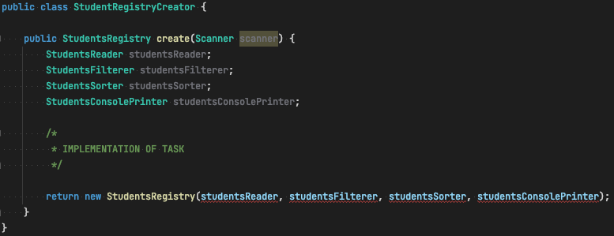
Flexible solution

Slide 3
Homework. Students Registry
Add annotation @Dependency
Mark "dependency" classes with a @Dependency annotation (“dependency” – it’s a class which is passed as constructor argument for some other class, it means “class A depends on class B”)

Slide 4
Homework. Students Registry
Find all Dependency classes(it means: Scan application for Class<?> objects that annotated with annotation @Dependency)
Create instances of ”dependency” classes by using Reflection API
Create an instance of StudentsRegistry class by injecting “dependency” objects using Java Reflection API

Slide 5
Thanks!
Any Questions?
Or find us in Slack:
@Yaroslav Brahinets
@Vasya Rudas

